Slide 1
MUSIC APP

Slide 2
Topics need to discuss
1.Detailed description of music app
2.Requirements used in music app
3.What are Micro services in Music app
4.Flow chart
5.Class Diagram
6.Conclusion

Slide 3
Detailed Description of music app
1. Fill your world with the songs, albums and artists that define you. Get unlimited access to millions of tracks, curated playlists and original content from the artists you know and love.
2. Music app is developed on spring boot. In music app we have player list which we can play the music track by searching artist name.

Slide 4
Requirements used in Music App
1.Hard Ware Requirements:
CPU: 1.2 GHz Processor
RAM: Minimum 1GB
Hard Disk: 10GB

Slide 5
2.Software Requirements:
JDK-11
MongoDB
Junit 5
Mockito
Spring Suite Tool IDE
Web Server
Postman
Git

Slide 6
Micro Services
Music Category
Play List Service
Album Service
Contact Service

Slide 7
Micro Services
Music Category:
The User can choose favourite music as their own choice. User can also make changes in the favourite list they can add, remove the songs from list. Also it can fetch the details by searching Songs by their Id.
Play List
The user can create their playlist with id and they can add songs what they want. In playlist the user can also find artist name with song name.
Album
The User can choose their album and they can see details like album name, song name, artist name and they can view what songs they want.
Contact Service
In this we have admin if user have any difficulty user can check the information and give the details.

Slide 8
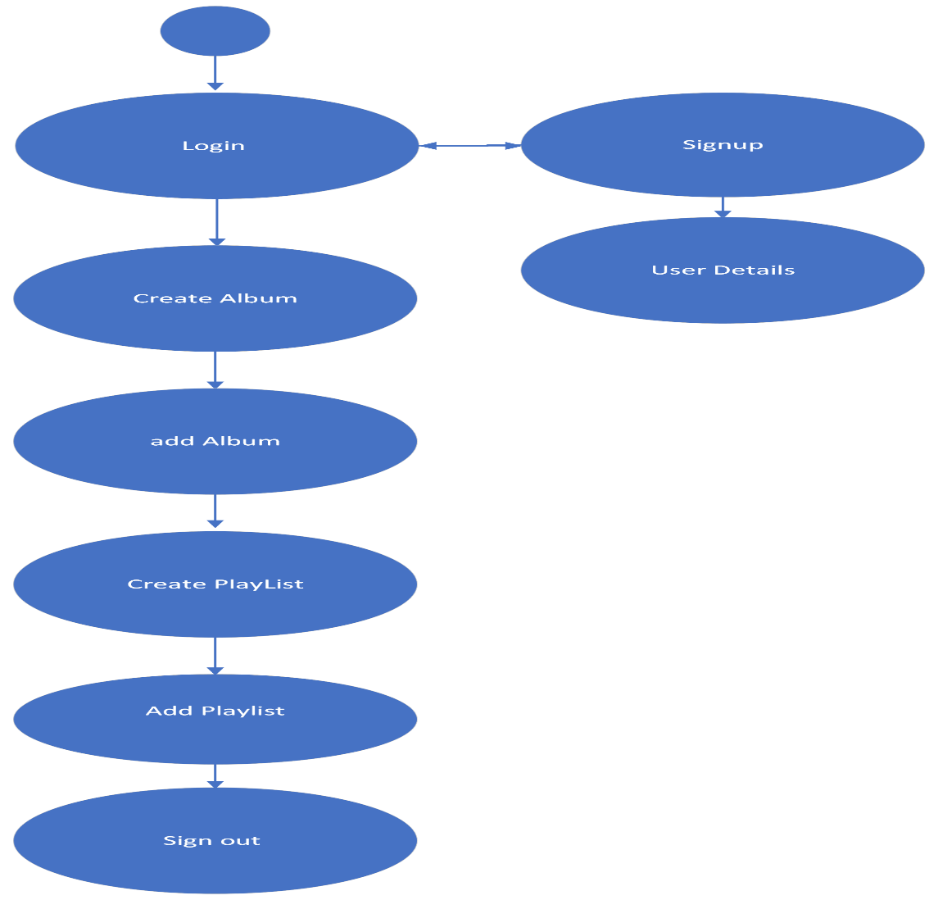
Flow Chart

Slide 9
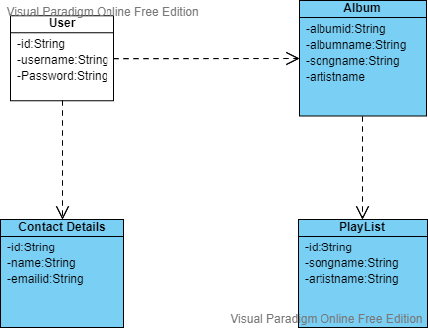
Class Diagram

Slide 10
Conclusion
User can signup and login into the music app
User can add and delete songs. User has to register itself to access music player.
User can use this service free of cost.

